Slide 1
UEN002 – Energy and Environment
In the previous session, we went through…..
Composting process of biodegradable municipal solid waste

Slide 2
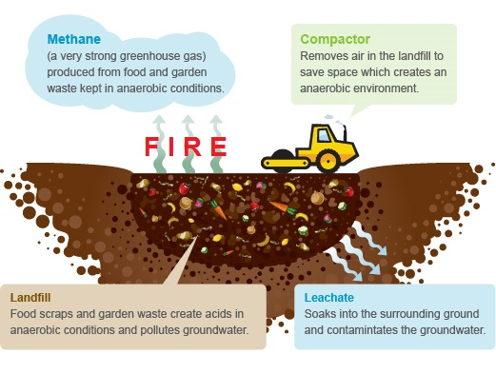
Conventional Dumping

Slide 3
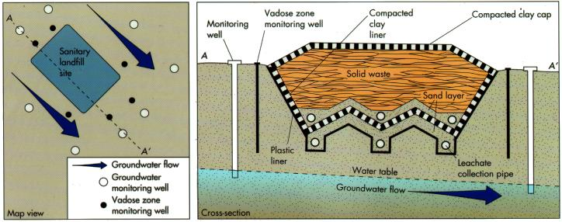
Sanitary landfills

Slide 4
Planning and Siting of landfills
Important prerequisites for calculation of the size involves
  records of historical information on community size and disposal quantities
  In place density (density after compaction) and volume of cover material
  Anticipation/prediction on possible changes in
    Regulations
    Competing facilities
    Different cover options
    Non-residential waste changes
Once the size of the landfill has been determined, it is necessary to find the appropriate site
For a local community or regional agency, an appropriate landfill size is typically within the geographical boundary of the agency

Slide 5
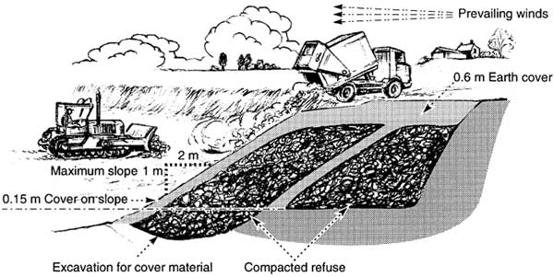
Planning and Siting of landfills
Important prerequisites for location of the landfill
  Locations to be avoided include seismic zones, watershed areas, flood plains, wetlands and airports
  Downwind direction of the areas of human inhabitation

Slide 6
Landfill operations
Filling sequences
At an active landfill daily deliveries of wastes are placed in layers (or lifts) on top of the liner and leachate collection system to depth of 20 m or greater
The common techniques of layering are
  Area or mound type
  Excavation or trench type
It is important that leachate collection system is protected during layering
Therefore, waste in the first lift is selected to avoid heavy and sharp objects – the operational layer
The waste also must be placed in a manner to keep compactor wheels away from leachate collection system

Slide 7
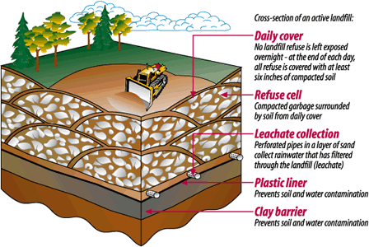
Landfill operations
Daily cover
Waste is covered at the end of each working day with soil or alternative covers.
Daily cover is required to control disease vectors, rodents and to minimize odours, litter and air emissions
Even during the daily cover formation, the landfill sides are sloped to facilitate maintenance and to increase slope stability gradually

Slide 8
Landfill processes
Biological degradation
Refuse is approximately 75 to 80% organic matter, composed of proteins, lipids, carbohydrates (cellulose/hemicellulose) and lignins
Approximately 2/3rd biodegradable and 1/3rd recalcitrant
Biodegradable portion:
  Moderate – paper, textile and wood
  Readily – food and yard waste
Landfill ecosystem is extremely diverse and dependent upon nature of waste and operating conditions
It is influenced by – pH, temperature, presence of toxins, moisture content and redox potential

Slide 9
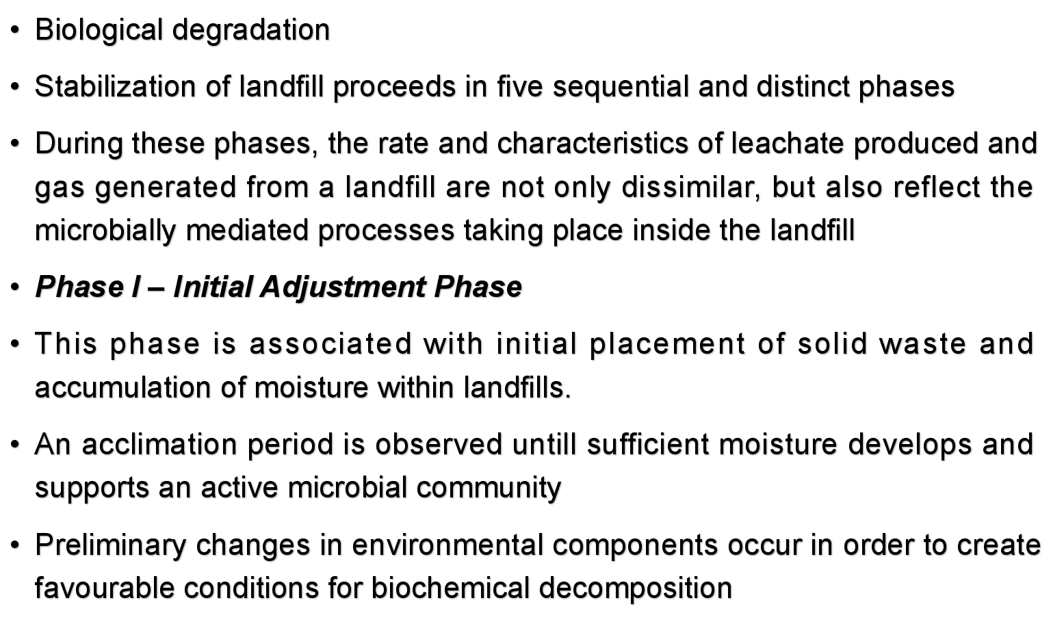
Landfill processes

Slide 10
Landfill processes
Phase II– Transition Phase
In this phase, the field capacity is often extended and a transformation from aerobic to an anaerobic environment occurs
A trend towards reducing conditions is established in accordance with shifting of electron acceptors from oxygen to nitrates and sulphates and displacement of oxygen by carbondioxide
By end of this phase measurable concentrations of COD and VOCs can be detected in leachates

Slide 11
Landfill processes
Phase III– Acid Formation Phase
The continuous hydrolysis of solid waste con-comitant with the microbial conversion of biodegradable organic content, results in production of intermediate volatile organic acids at high concentrations.
A decrease in pH is often observed accompanied by metal species solubilization
Viable biomass growth associated with the acid formers and rapid consumption of substrate and nutrients are the predominant features of this phase

Slide 12
Landfill processes
Phase IV– Methane Fermentation Phase
During this phase intermediate acids are consumed by methane-forming consortia and converted to methane and carbondioxide.
Sulphate and nitrates are reduced to sulfides and ammonia respectively
The pH is elevated and consequently supports the growth methane formers
Heavy metals are removed from the leachate by complexation and precipitation

Slide 13
Landfill processes
Phase V– Maturation Phase
During the final state of landfill stabilization, nutrients and available substrate become limiting factors, and the biological activity shifts to relative dormancy
Gas production dramatically drops
Leachate strength stays steady at much lower concentrations
Reappearance of oxygen and oxidized species may be observed
However, the slow degradation of resistant organic fractions may continue till the production of humic-like substances
The progress towards final stabilization is subject to the physical, chemical and biological factors within the landfill environment, the age and characteristics of landfilled waste, the operational and management controls applied as well as site specific external factors

Slide 14
Geotechnical Aspects
Landfill stability is an important aspect of the design
Failures can occurs as
  Slope failures during construction of landfill
  Slope failures after the landfill has been closed
Critical point of failure is usually at
  Soil/geosynthetic layer
  Geosyn./geosyn. Layer
Landfill failures can cause catastrophic results including
  Damage to leachate and gas collection systems
  Contamination of environment and GW resources
  Loss of life in extreme conditions

Slide 15
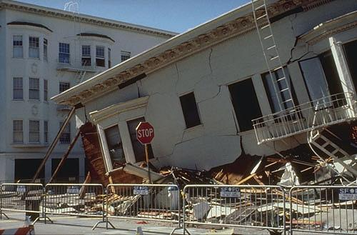
Geotechnical Aspects
The operation of landfill as a bioreactor can create unique geotechnical conditions
Increased moisture content leading to waste saturation can result in positive internal pore pressure
The impact of waste decomposition on shear strength is also of critical concern as it causes mud/slurry like conditions at bottom of wet and deep landfills
Overaggressive leachate recirculation is typical condition in such slurry formation – example of catastrophic irreparable condition – Colombia, South America

Slide 16
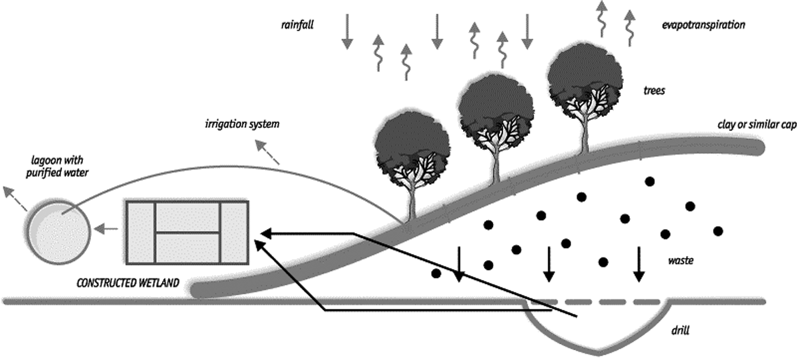
Geotechnical Aspects
Landfill CAP
Landfills have to capped regardless of the potential of the water intrusion
Once the landfill reaches a designed height, a final cap is placed to
  Minimize infiltration of water
  Minimize dispersion of wastes
  Accommodate settling
  Facilitate long-term maintenance of landfill
The cap may consist, from top to bottom, of vegetation and supporting soil, (1) a filler and drainage layer, (2) a hydraulic barrier, (3) foundation for hydraulic barrier and (4) a gas control layer.

Slide 17
Geotechnical Aspects
Landfill CAP
Slope stability and soil erosion are critical conditions for landfill caps
Typical slopes are 1:3 and 1:4
The interface friction between adjacent layers must resist seepage forces and may decrease the contact stresses between layers due to build up of water and/or gas pressures
A typical clay cover will constitute
  Revegetated layer (upto 6”)
  Protective material (18-36”)
  Drainage material (12”)
  Clay barrier (24”)
  Gravel layer (6”)

Slide 18
Geotechnical Aspects
Landfill CAP
As the landfill settles, caps can fail and allow stormwater into the landfill
The common failures are
  Dessication
  Rotation settling
  Cracking or shear settling
In terms of collection of storm water, the cap area should be facilitated by ditches, dikes, or culverts to divert flow and prevent formation of leachate

Slide 19
Landfill operations
Monitoring
Landfill monitoring is critical to the operation of the landfill
Most commonly, monitoring of landfill operations include
  Leachate head on liner
  Leakages in liner
  Groundwater quality
  Ambient air quality
  Gas in surrounding soil
  Leachate quality and quantity
  Landfill-gas quality and quantity
  Stability of final cover
Once the landfill is closed, the land can be used for many purposes
It is important to consider the final use of a landfill during planning and design phases to ensure that the configuration is compatible with selected final use

Slide 20
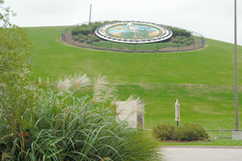
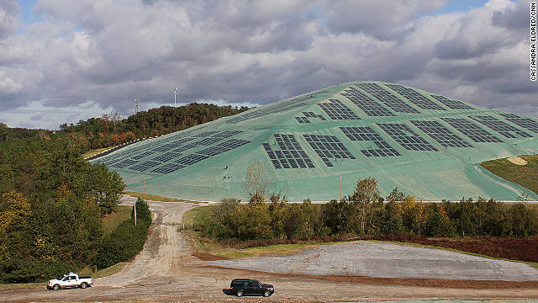
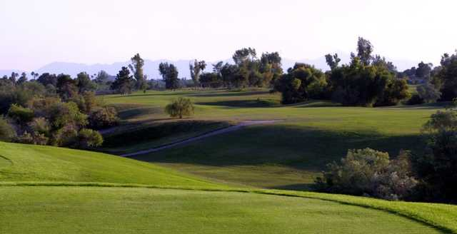
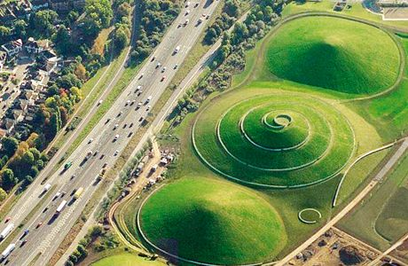
Post-closure care and use of old landfills
Final use alternatives include
  Golf courses (Illinois Golf Course, Chicago)
  Natural parks (Shabrat Alam, Malaysia)
  Solar land fill (Georgia)
  Ski slopes (Mount Trashmore)
  Parking lots (MIT Campus, Cambridge)

Slide 21
In the next……
You will be introduced to :
E-waste Management

